Slide 1






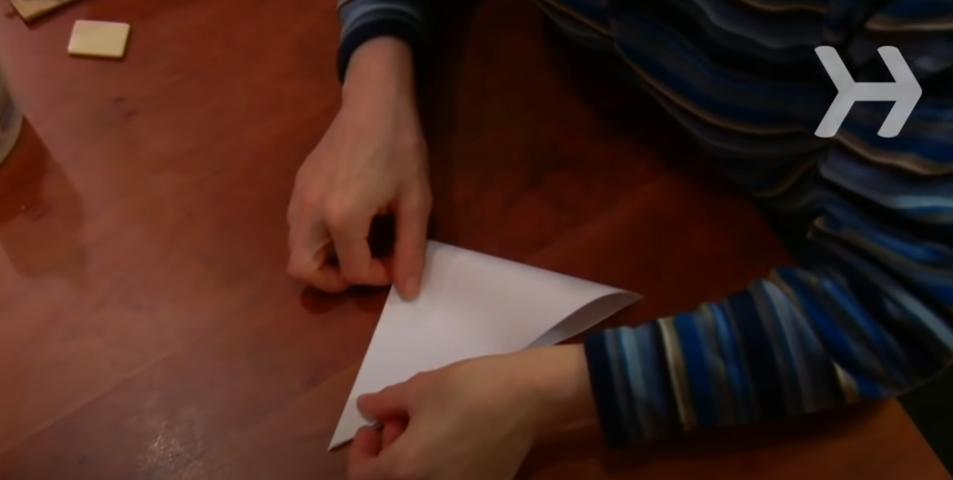
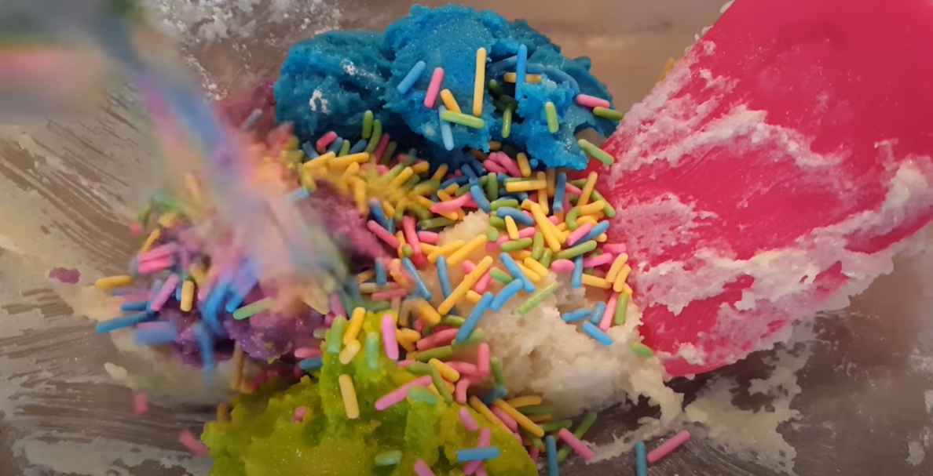
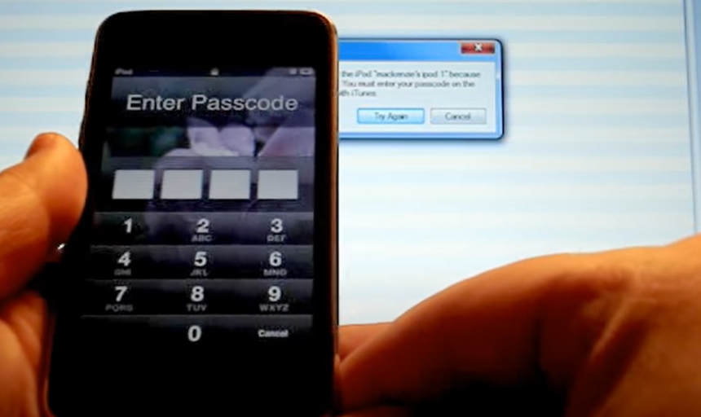
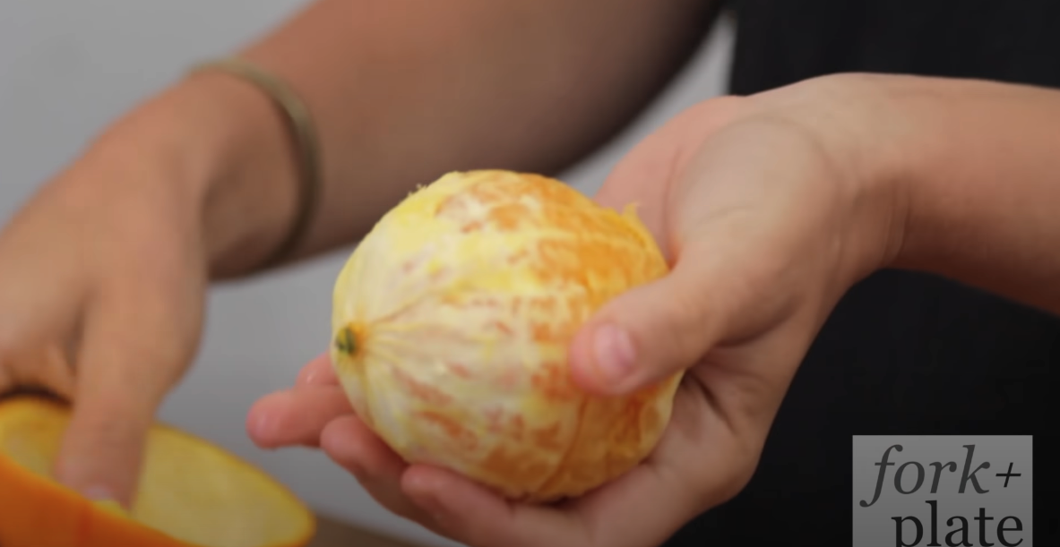
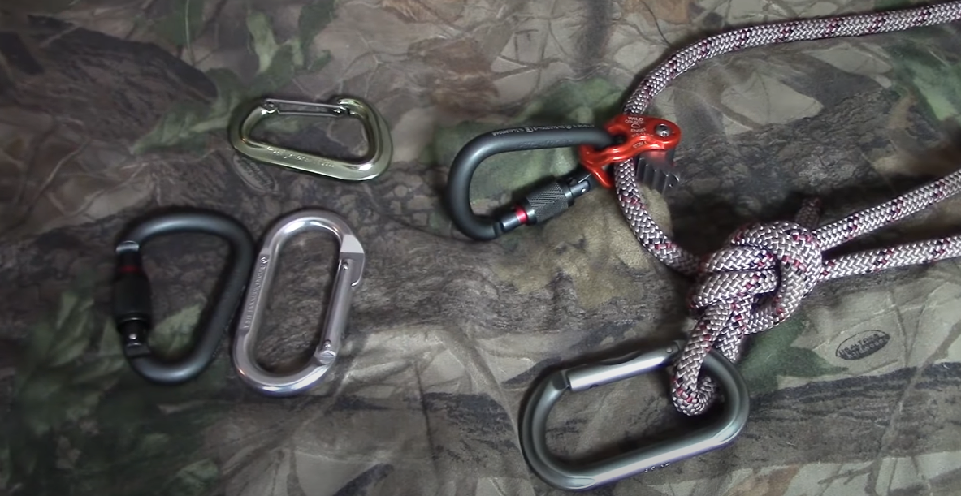
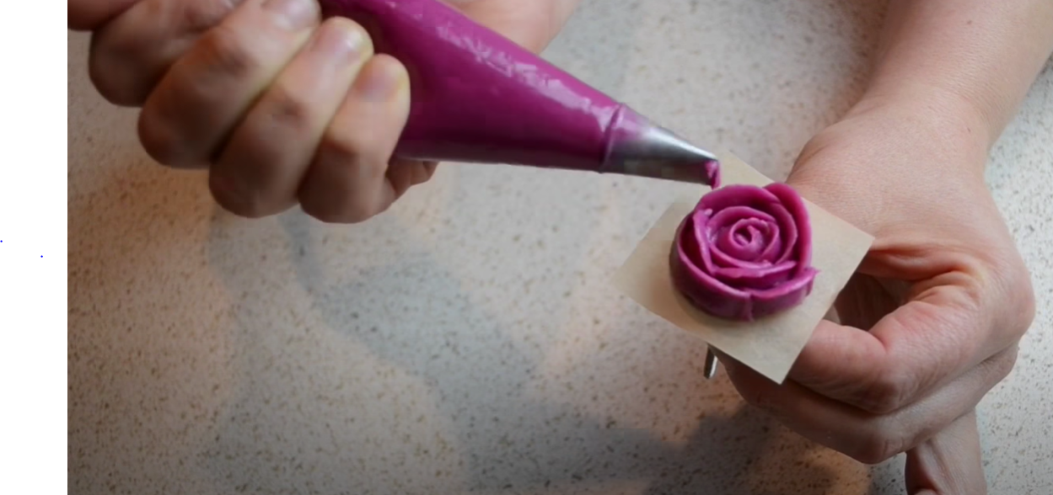
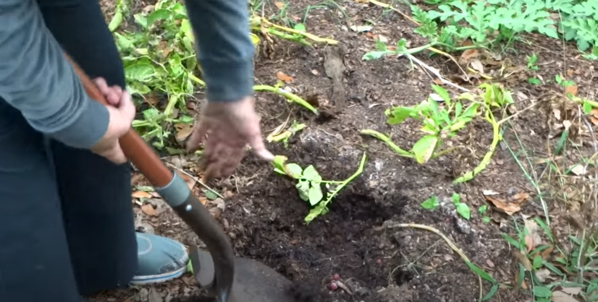
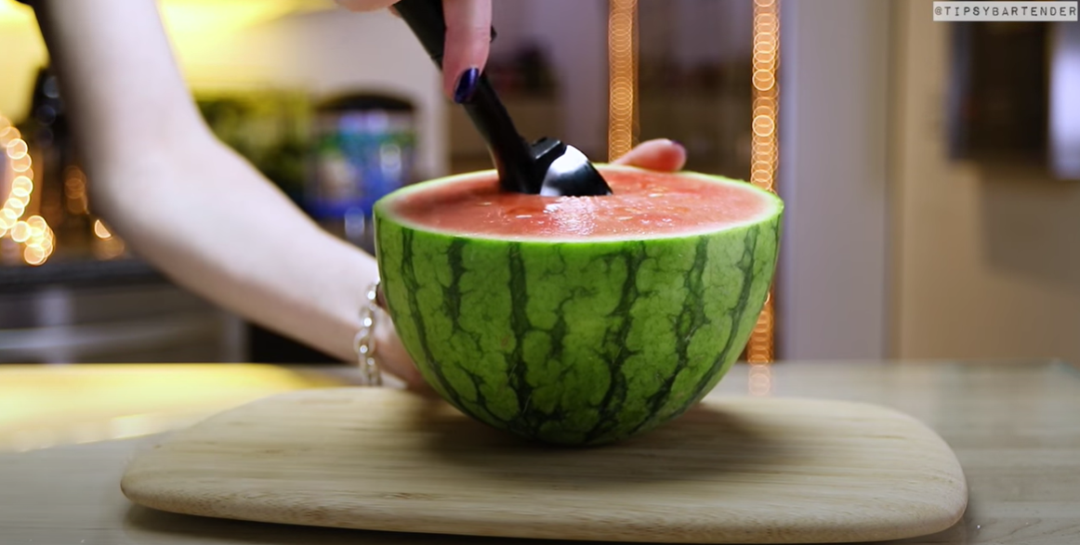

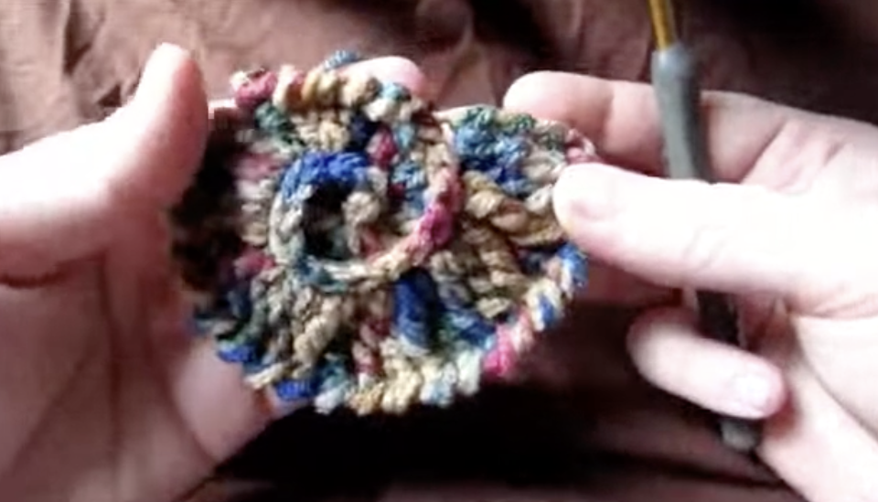

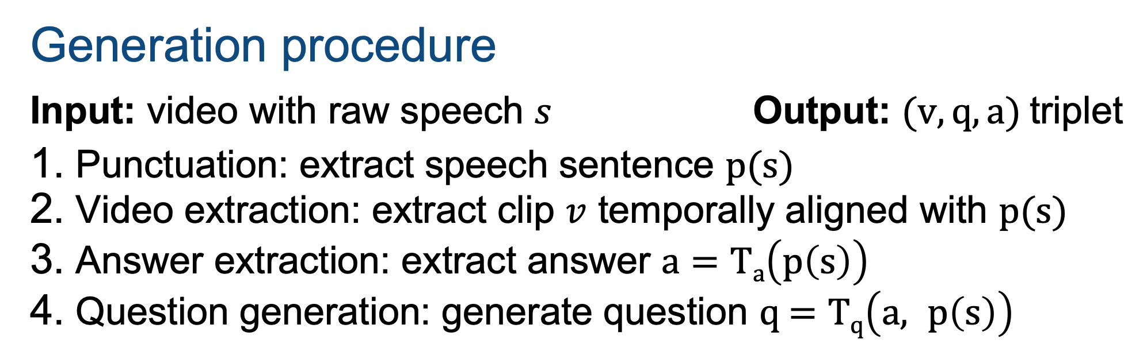
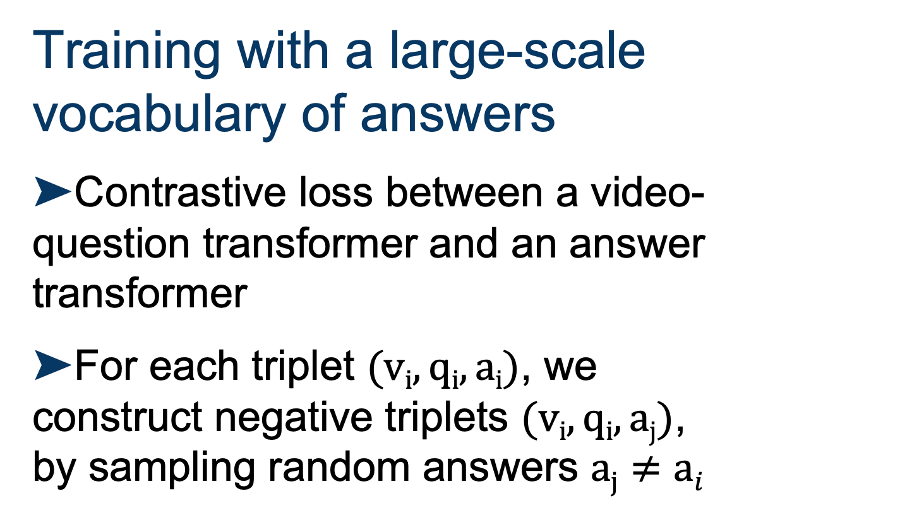
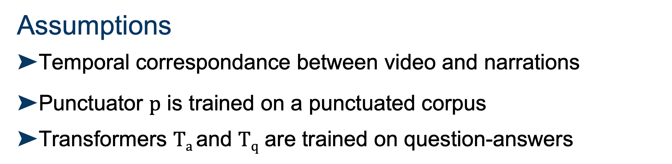
Just Ask: Learning to Answer Questions from Millions of Narrated Videos
Antoine Yang^{1,2}, Antoine Miech^{1,2,+}, Josef Sivic³, Ivan Laptev^{1,2}, Cordelia Schmid^{1,2}
¹Inria Paris ²Ecole Normale Supérieure, PSL ³CIIRC, CTU in Prague ⁺Now at DeepMind
Overview
HowToVQA69M: large-scale VideoQA training dataset
Zero-shot VideoQA
Motivation
➤Manual annotation for Video Question Answering is expensive
➤Text-only annotations are easier to obtain
Goal
➤Tackle Video Question Answering (VideoQA) without using any manual supervision of visual data
➤Generated from HowTo100M [1]
➤69M video-question-answer triplets
➤Noisy:
≃30% correct samples
≃31% question-answer generation errors
≃39% question-answers unrelated to video
Comparison of VideoQA datasets
Definition
➤No manual supervision of visual data
Quantitative results
➤Our model trained on HowToVQA69M (iii) outperforms its language-only variant (i) and its variant trained on HowTo100M [1] (ii)
Method | Pretraining data | iVQA | MSRVTT-QA | MSVD-QA | ActivityNet-QA | How2QA
Random | ∅ | 0.09 | 0.02 | 0.05 | 0.05 | 25.0
QA-T (i) | HowToVQA69M | 4.4 | 2.5 | 4.8 | 11.6 | 38.4
VQA-T (ii) | HowTo100M | 1.9 | 0.3 | 1.4 | 0.3 | 46.2
VQA-T (iii) | HowToVQA69M | 12.2 | 2.9 | 7.5 | 12.2 | 51.1
Idea
➤Automatically generate VideoQA training data from narrated videos
➤Rely on cross-modal supervision and language models trained on text-only annotations
Qualitative results
Speech: Fold them in half again, to make a triangle.
Speech: Add some of your favorite sprinkles give it a mix.
Question: What can you add to the mix?
Answer: sprinkles
Speech: ...I'm going to show you how to unlock your ipod touch.
Question: What will I show you?
Answer: how to unlock your ipod touch
Speech: …do it on the other side, and you've peeled your orange
Question: What color did you peel on the other side?
Answer: orange
Speech: ...I’ve had over a hundred emails.
Question: How many emails have I had?
Answer: over a hundred
Generated Question: How do you make a triangle?
Generated Answer: fold them in half again
Question: What design are they making?
GT Answer: rose (4), rose flower (1)
QA-T (i): pinwheel
VQA-T (ii): piping bag
VQA-T (iii): rose
Question: What is in the man's hand?
GT Answer: shovel (3), spade (2)
QA-T (i): coin
VQA-T (ii): planting
VQA-T (iii): shovel
Question: What fruit is shown at the end?
GT Answer: watermelon (5)
QA-T (i): pineapple
VQA-T (ii): slotted spoon
VQA-T (iii): watermelon
Generating VideoQA data
Question-answer generation error
Question-answer unrelated to the video
Training on HowToVQA69M
Training with a large-scale vocabulary of answers
➤Contrastive loss between a video-question transformer and an answer transformer
➤For each triplet $(vi, qi, ai)$, we construct negative triplets $(vi, qi, aj)$, by sampling random answers $aj≠ai$
Results after finetuning
➤Our model pretrained on HowToVQA69M (iii) improves over its variant trained from scratch (i) and its variant pretrained on HowTo100M [1] (ii)
➤State-of-the-art results on 4 existing VideoQA datasets
Method | Pretraining data | iVQA | MSRVTT-QA | MSVD-QA | ActivityNet-QA | How2QA
HCRN [2] | ∅ | . | 35.6 | 36.1 | . | .
SSML [3] | HowTo100M | . | 35.1 | 35.1 | . | .
ClipBERT [4] | COCO + VG | . | 37.4 | . | . | .
HERO [5] | HowTo100M + TV | . | .. | . | . | 74.1
CoMVT [6] | HowTo100M | . | 39.5 | 42.6 | 38.8 | 82.3
Ours (i) | ∅ | 23.0 | 39.6 | 41.2 | 36.8 | 80.8
Ours (ii) | HowTo100M | 28.1 | 40.4 | 43.5 | 38.1 | 81.9
Ours (iii) | HowToVQA69M | 35.4 | 41.5 | 46.3 | 38.9 | 84.4
Assumptions
➤Temporal correspondance between video and narrations
➤Punctuator $p$ is trained on a punctuated corpus
➤Transformers $Ta$ and $Tq$ are trained on question-answers
iVQA: new dataset for VideoQA evaluation
Generation procedure
Input: video with raw speech $s$ Output: ($v, q, a)$triplet
Punctuation: extract speech sentence p(s)
Video extraction: extract clip $v$ temporally aligned with p(s)
Answer extraction: extract answer $a=Ta\left(p\left(s\right)\right)$
Question generation: generate question q $=Tq\left(a, p\left(s\right)\right)$
➤10,000 videos from HowTo100M [1]
➤Manually annotated
➤10,000 open-ended questions
➤5 correct answers per question
➤Exclusion of non-visual questions to reduce language bias
Question: What shape is the handcraft item in the end?
References
Answers
shell
2 annotators
[1] A. Miech et al., HowTo100M: Learning a Text-Video Embedding by Watching Hundred Million Narrated Video Clips. In ICCV, 2019.
[2] TM. Le, et. al., Hierarchical conditional relation networks for video question answering. In CVPR, 2020.
[3] E. Amrani, et. al., Noise estimation using density estimation for self-supervised multimodal learning. In AAAI, 2021.
[4] J. Lei, et. al., Less is more: Clipbert for video-and-language learning via sparse sampling. In CVPR, 2021.
[5] L. Li, et. al., HERO: Hierarchical encoder for video+language omni-representation pre-training. In EMNLP, 2020.
[6] PH. Seo, et. al., Look before you speak: Visually contextualized utterances. In CVPR, 2021.
spiral
2 annotators
heart
1 annotator

